Slide 1


Torrell Williams
5-14-24

Slide 2

Outline
Executive Summary
Introduction
Methodology
Results
Conclusion
Appendix

Slide 3
Executive Summary
Objective: The objective of this capstone is to predict if Falcon 9 first stage will land successfully using several methodologies, listed below.
Summary of methodologies
Data Collection through API
Data Collection with Web Scraping
Data Wrangling
Exploratory Data Analysis with SQL
Etc.
Summary of all results
Results will be display in a variety of formats and graphs which can be found in the notebooks and some in this presentation.

Slide 4
Introduction
Project background and context
The goal of this project is to determine if stage 1 will successfully land and if so determine the overall cost of the launch.
Problems you want to find answers
The relationship between the variables and end result
Best conditions to achieve a successful landing
Factors that lead to a successful landing

Slide 5

Section 1

Slide 6
Methodology
Executive Summary
Data collection methodology:
Web scrapping from Wikipedia
SPACEX REST API
Perform data wrangling
One-hot encoding for models
Perform exploratory data analysis (EDA) using visualization and SQL
Perform interactive visual analytics using Folium and Plotly Dash
Perform predictive analysis using classification models
How to build, tune, evaluate classification models

Slide 7
Data Collection
Describe how data sets were collected.
Rest API’s and web scrapping was utilized in order to collect data.
Web Scrapping
Utilizing BeautifulSoup we parsed a launch table from the Wikipedia page and converted into a pandas dataframe for analysis.
Rest API
Information such as rocket type, launches, and payload were collected from the API.

Slide 8
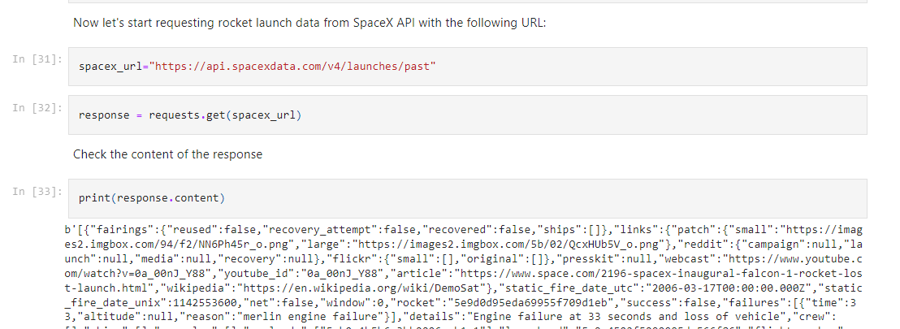
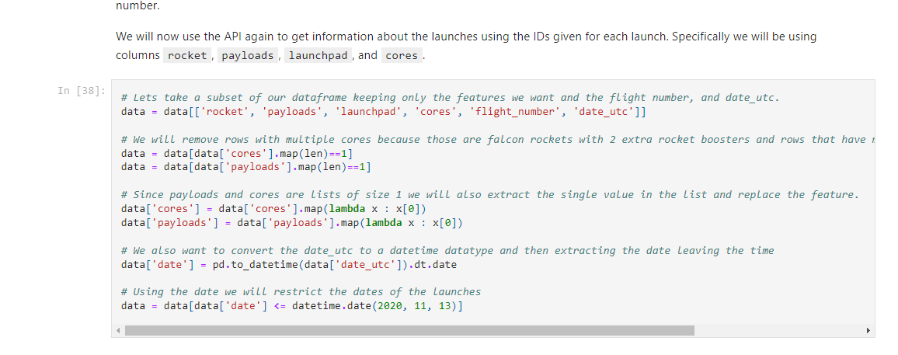
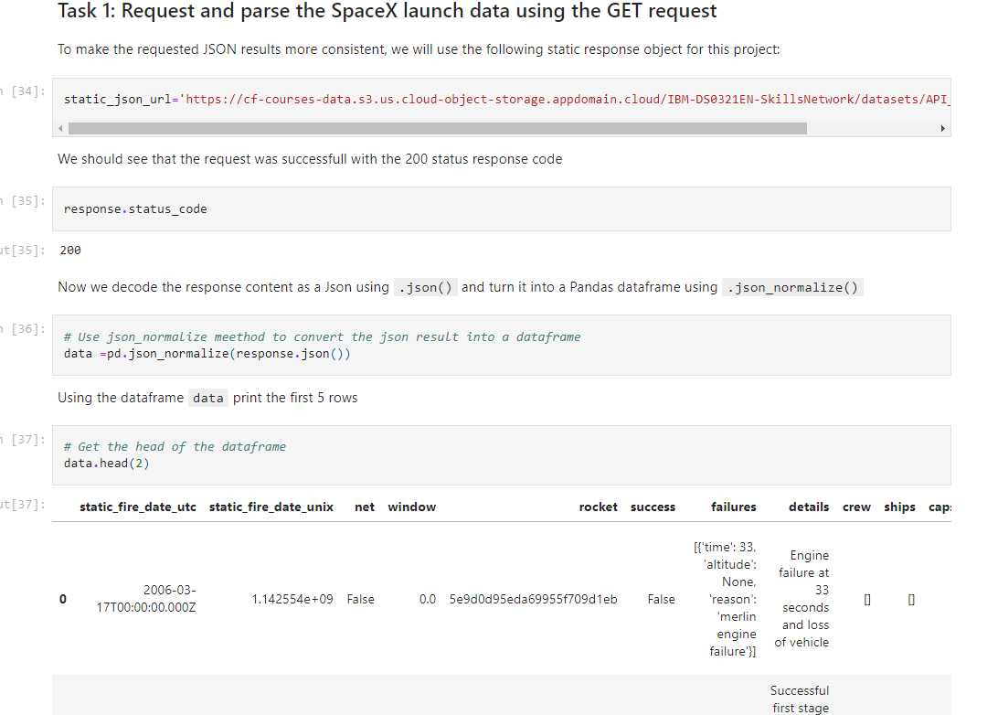
Data Collection – SpaceX API
I initiated a get request to the SpaceX API to gather the data. Then I cleaned the data before formatting and wrangling.
GitHub URL: https://github.com/RellyRell/IBM-Capstone-SpaceY/blob/main/jupyter-labs-spacex-data-collection-api.ipynb
Place your flowchart of SpaceX API calls here

Slide 9
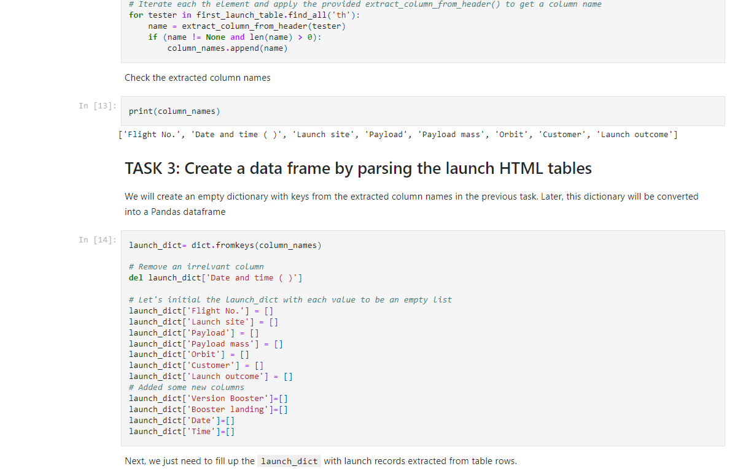
Data Collection - Scraping
Utilizing web scrapping techniques and Beautiful soup I pulled records for the Falcon 9 launch
GitHub URL https://github.com/RellyRell/IBM-Capstone-SpaceY/blob/main/jupyter-labs-webscraping.ipynb
Place your flowchart of web scraping here

Slide 10
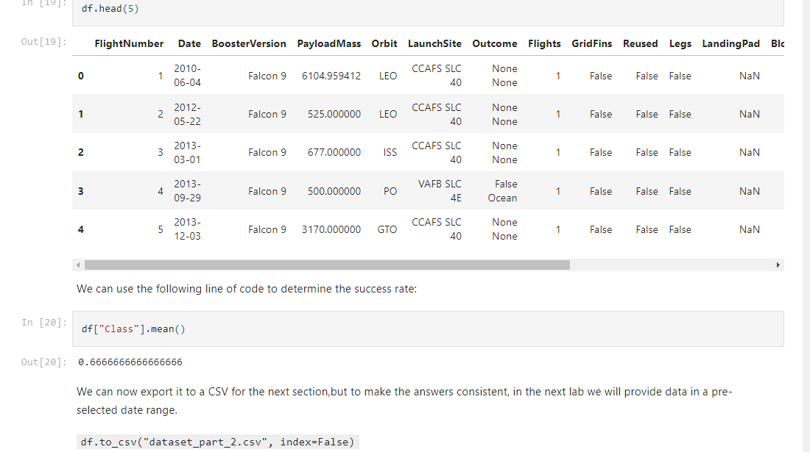
Data Wrangling
My objective was to calculate the number of launches at each site, occurrence of each orbits, and the number .
A csv could be created and exported for further quantitative analysis
GitHub URL https://github.com/RellyRell/IBM-Capstone-SpaceY/blob/main/labs-jupyter-spacex-Data%20wrangling%20(1).ipynb

Slide 11
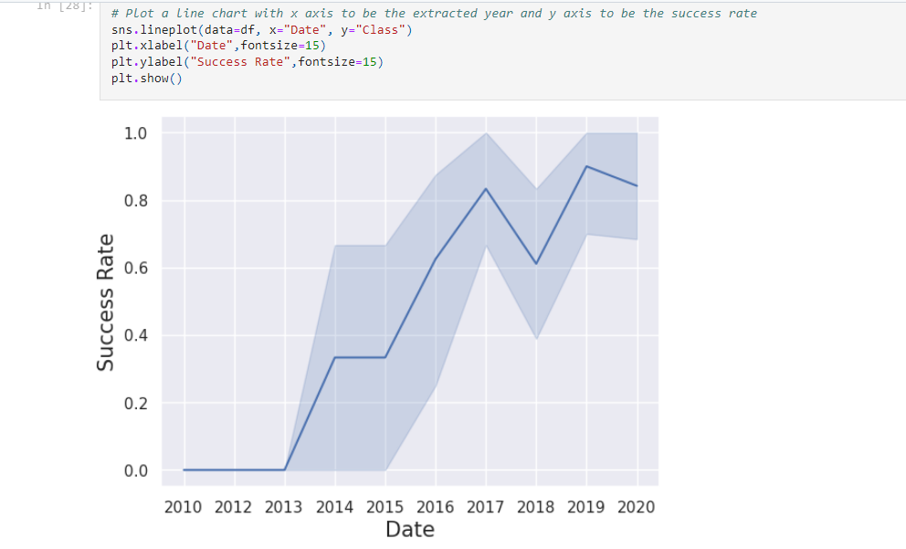
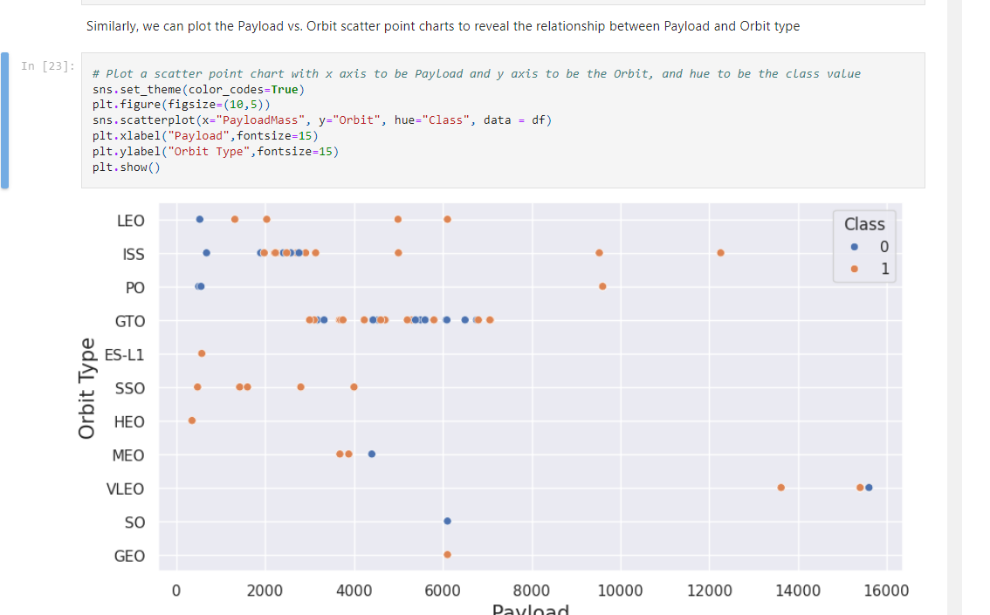
EDA with Data Visualization
The charts below visualize several relationships such as between success rate and date, orbit type and payload, etc.
GitHub URL https://github.com/RellyRell/IBM-Capstone-SpaceY/blob/main/edadataviz.ipynb

Slide 12
EDA with SQL
A few of the following queries were performed:
Displaying the names of the unique launch sites in the space mission
Displaying 5 records where launch sites begin with the string ‘CCA'
Displaying the total payload mass carried by boosters launched by NASA (CRS)
Displaying average payload mass carried by booster version F9 v1.1
Listing the date when the first successful landing outcome in ground pad was achieved using the min function
Listing the names of the boosters which have success in drone ship and have payload mass greater than 4000 but less than 6000
Total of successful and failed mission outcomes
https://github.com/RellyRell/IBM-Capstone-SpaceY/blob/main/jupyter-labs-eda-sql-coursera_sqllite%20(1).ipynb

Slide 13
Build an Interactive Map with Folium
I marked all launch sites, I also added map objects to display various data points. Objects such as circles or lines were used to identify a success or failure of launches.
Using the color-labeled marker clusters, I identified which launch sites have higher success rate.
I calculated the distances between a launch site to its proximities.

Slide 14
Build a Dashboard with Plotly Dash
I used Plotly dash to build an interactive dashboard.
The dashboard includes pie charts which display the total launches by a certain sites
I also used scatter plot graphs to show the relationship between Outcome and Payload
Notebook link: https://github.com/RellyRell/IBM-Capstone-SpaceY/blob/main/plotlydash

Slide 15
Predictive Analysis (Classification)
The predictive analysis was tricky. Utilizing the basics of pandas and numpy I was able to build a model.
I clean/transformed the data, then split the data for training and testing.
I tested the model for accuracy and used algo tuning and feature engineering.
Link: https://github.com/RellyRell/IBM-Capstone-SpaceY/blob/main/SpaceX_Machine%20Learning%20Prediction_Part_5%20(1).ipynb

Slide 16
Results
Exploratory data analysis results
Interactive analytics demo in screenshots
Predictive analysis results

Slide 17

Section 2

Slide 18
Conclusions
Based on analysis of all the data we can conclude that:
All launch sites are close to the coast
The decision tree proved to be the model.
Launch success steadily increased over time
Out of all the launch sites KSC LC
39A had the most successful launches.

Slide 19


